Slide 1
Delivering Value
Supporting your Service

Slide 2
Nyxoid Nasal Naloxone

Slide 3

Training Video

Slide 4
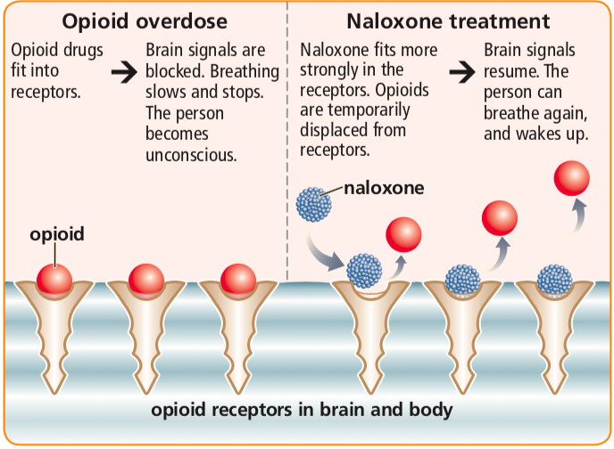
How naloxone works

Slide 5
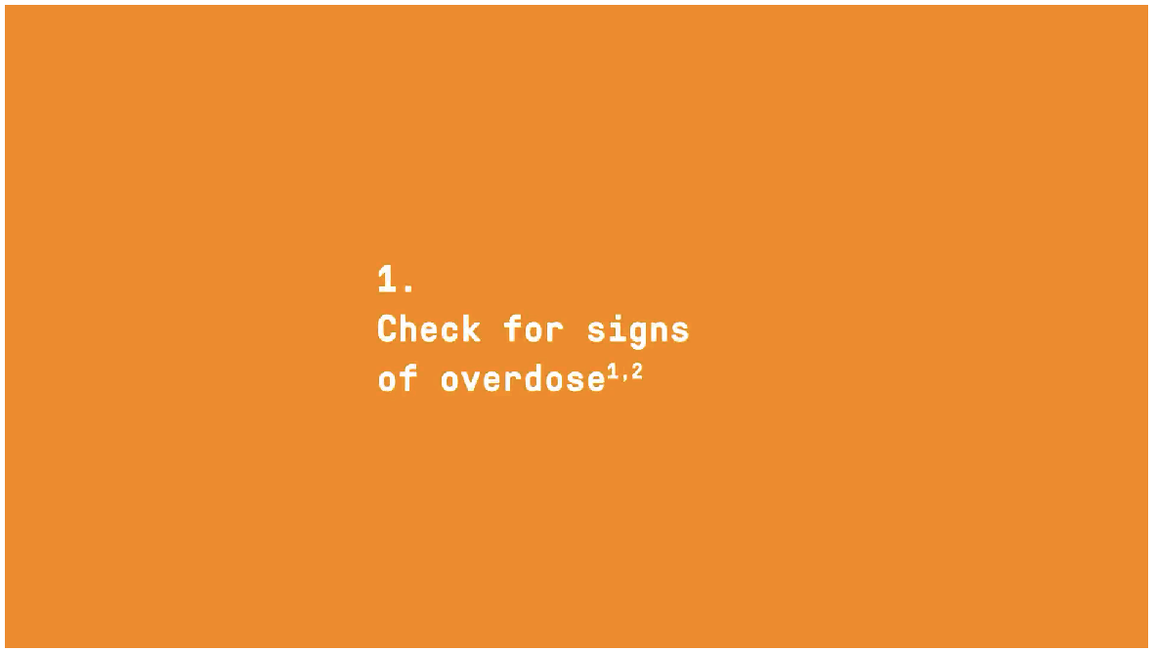

Slide 6
Check for signs of overdose
Check for signs of overdose
Approach with care
  Check for danger
  Check for any injecting equipment that may be lying around
Check for a response
  Is the person conscious?
    Shout
    Talk loudly into the ear
    Gently shake their shoulders
    Rub their sternum with knuckles
    Pinch their ear or bed of the fingernail

Slide 7
Check for signs of overdose
Check for signs of overdose
Check airway and breathing
  Clear mouth and nose of blockages
  Check for breathing
    Is the chest moving?
    Can you hear breathing?
    Can you feel breath on your cheek?
Check for signs of overdose
  No response to touch or sound
  Slow, uneven or no breathing
  Snorting, gasping or gulping
  Blue or purple fingernails and/or lips

Slide 8
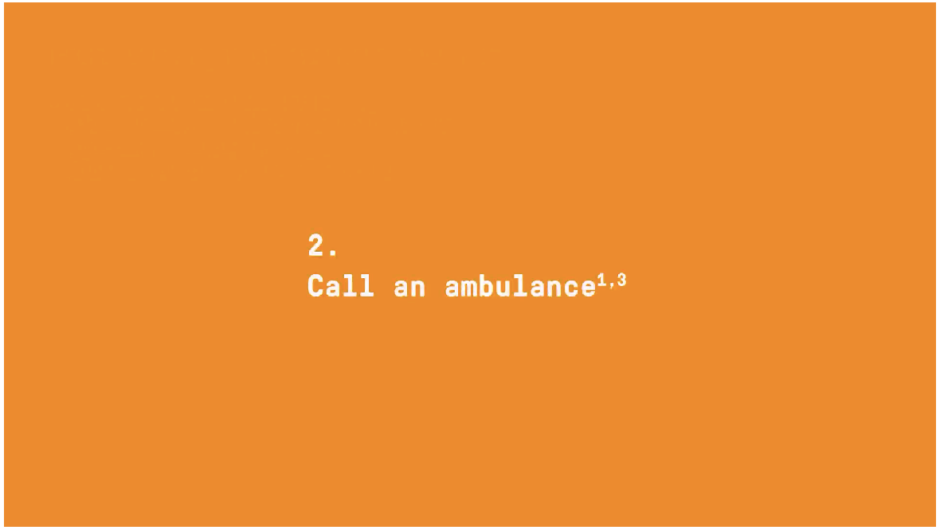

Slide 9
Call an ambulance
Always call for emergency services immediately
  Even if the person regains consciousness
Nyxoid is not a substitute for emergency medical care or basic life support
Put your phone on loudspeaker mode if possible to keep hands free
Give the emergency services as much information as possible
  Exact location
  Post code
  Substance taken
  Whether the person is conscious and breathing
  Inform the call handler that you intend to administer Nyxoid

Slide 10
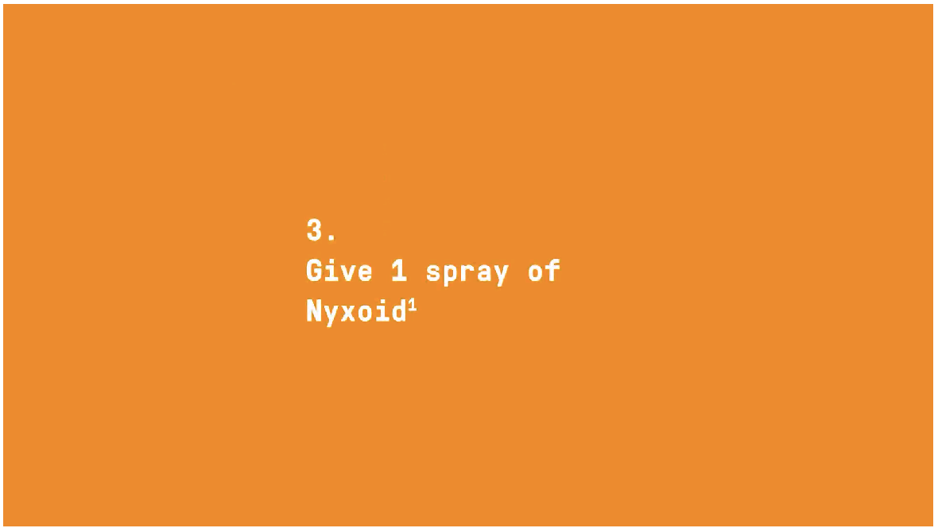

Slide 11
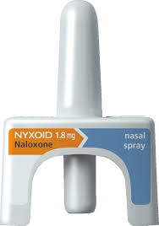
Give 1 spray of Nyxoid
Each box contains 2x 1.8mg nasal sprays (2 single doses)
  Each spray contains one dose only of 1.8mg
The blister pack contains pictorial instructions for use
  Peel off the rear of the blister pack
  Lay the person on their back
  Support the neck and let the head tilt back
  Hold the spray as shown on the next slides

Slide 12
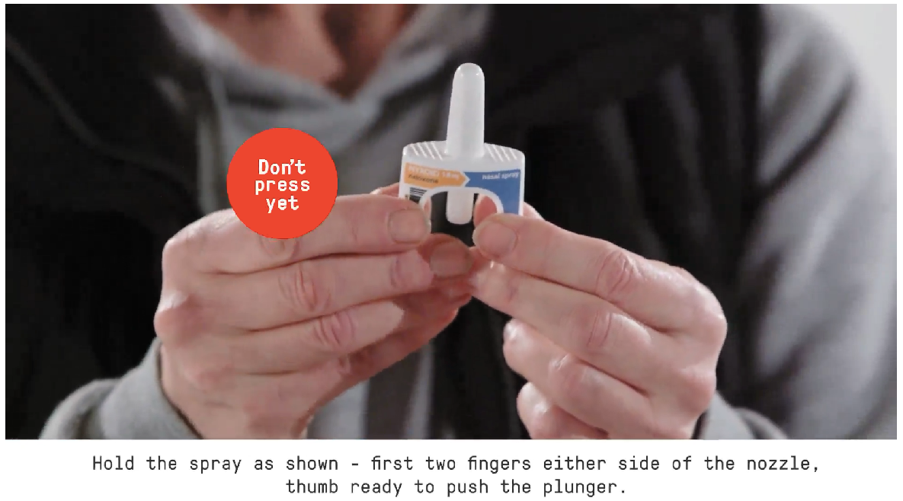
Give 1 Spray of Nyxoid

Slide 13
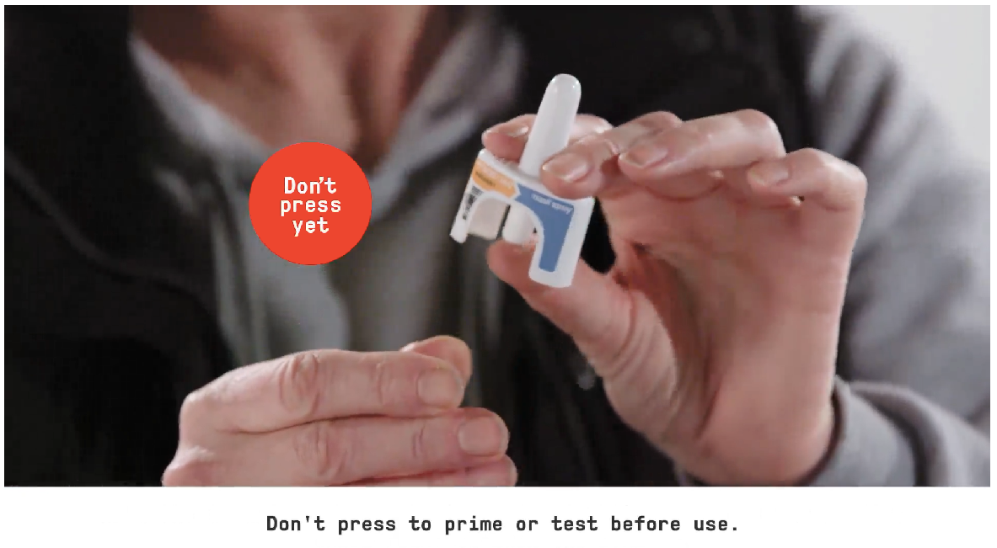
Give 1 Spray of Nyxoid

Slide 14
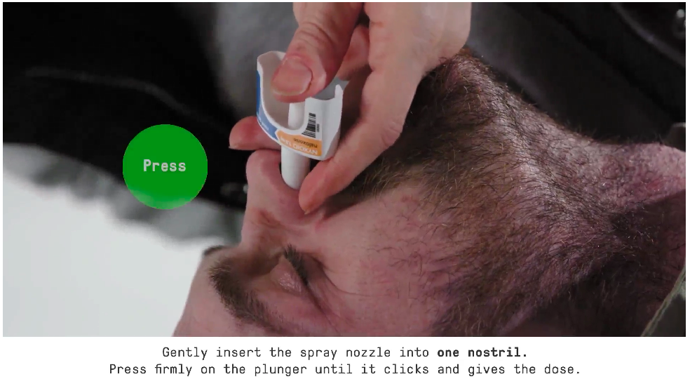
Give 1 Spray of Nyxoid

Slide 15
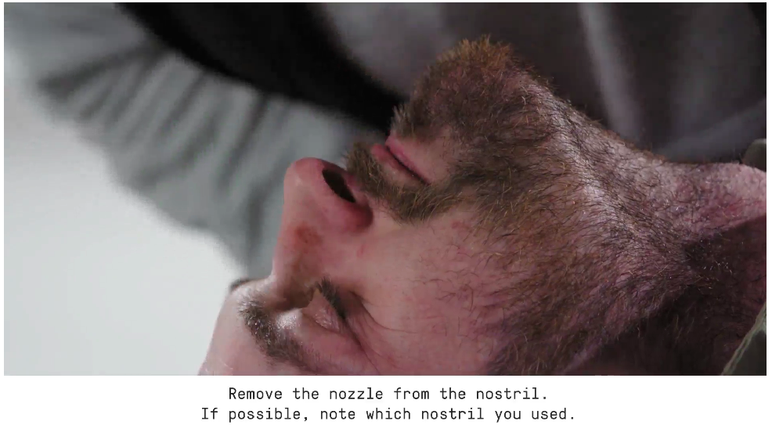
Give 1 Spray of Nyxoid

Slide 16
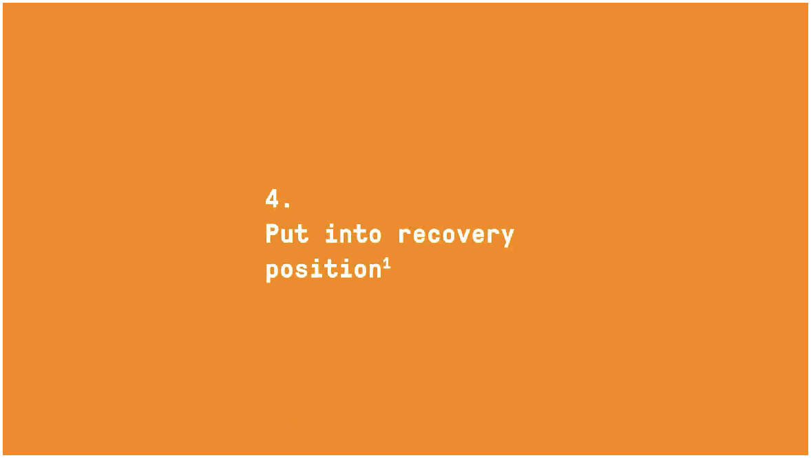

Slide 17
Put into recovery position

Slide 18
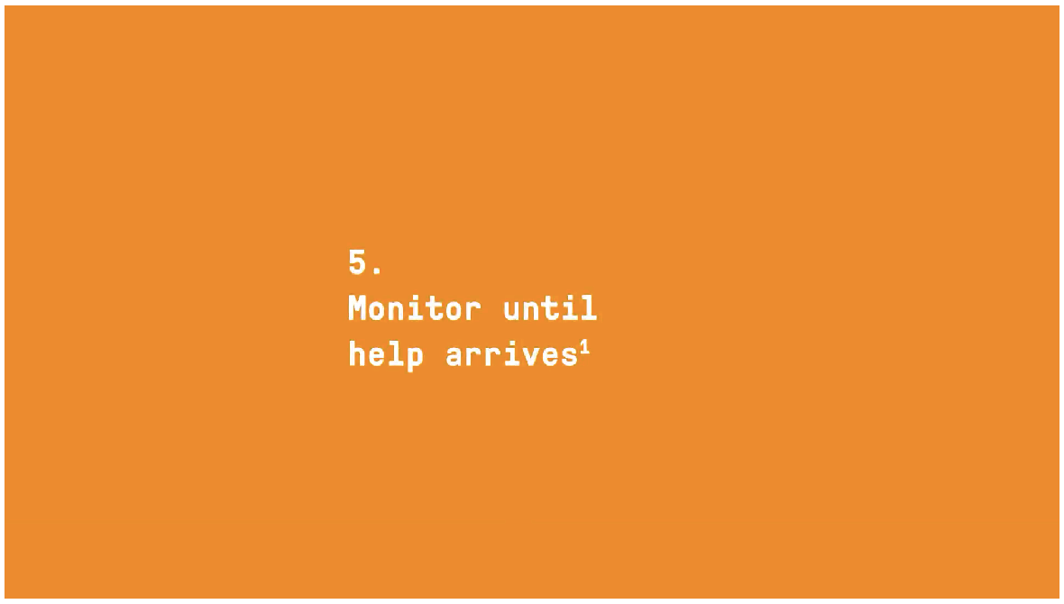

Slide 19
Monitor until help arrives
Stay with person
  Watch for improvements in breathing
  Watch for responses to sound and touch
If the person is unconscious and not breathing give basic life support (if trained to do so)
Be aware that even if they wake up they may lose consciousness again and stop breathing

Slide 20
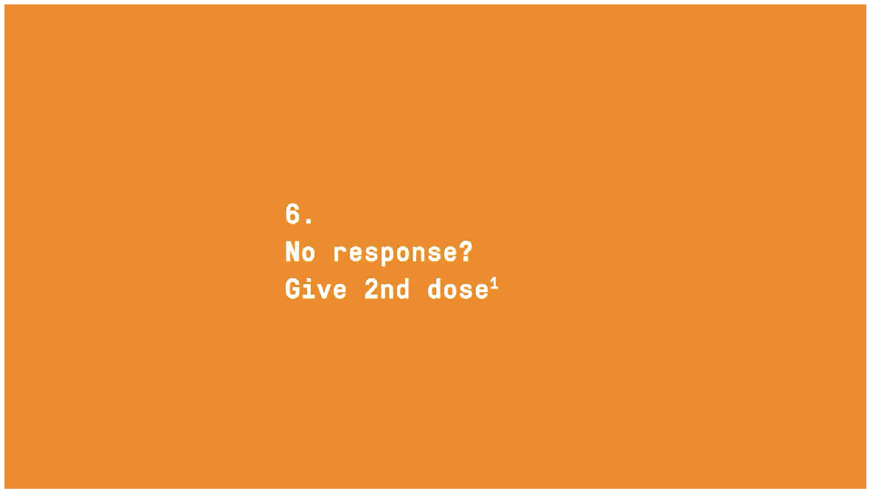

Slide 21
No response? Give 2nd dose
If there is no improvement in 2 to 3 minutes or if the overdose symptoms return use a new Nyxoid spray into the other nostril
You can do this whilst the person is in the recovery position

Slide 22
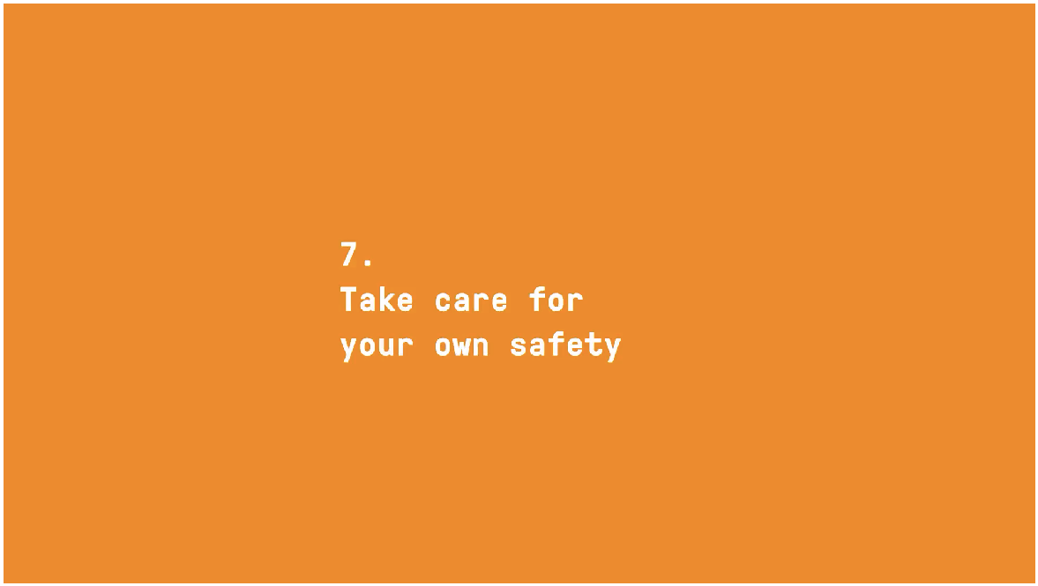

Slide 23
Take care for your own safety
Nyxoid can cause acute withdrawal symptoms if the person is opioid dependent
  Symptoms may include:
    Body aches and/or cramps
    Vomiting / nausea / diarrhea
    Fever / runny nose / sneezing
    Sweating / shivering / trembling
    Nervousness / irritability
Some people may seem to act aggressively as they wake up

Slide 24
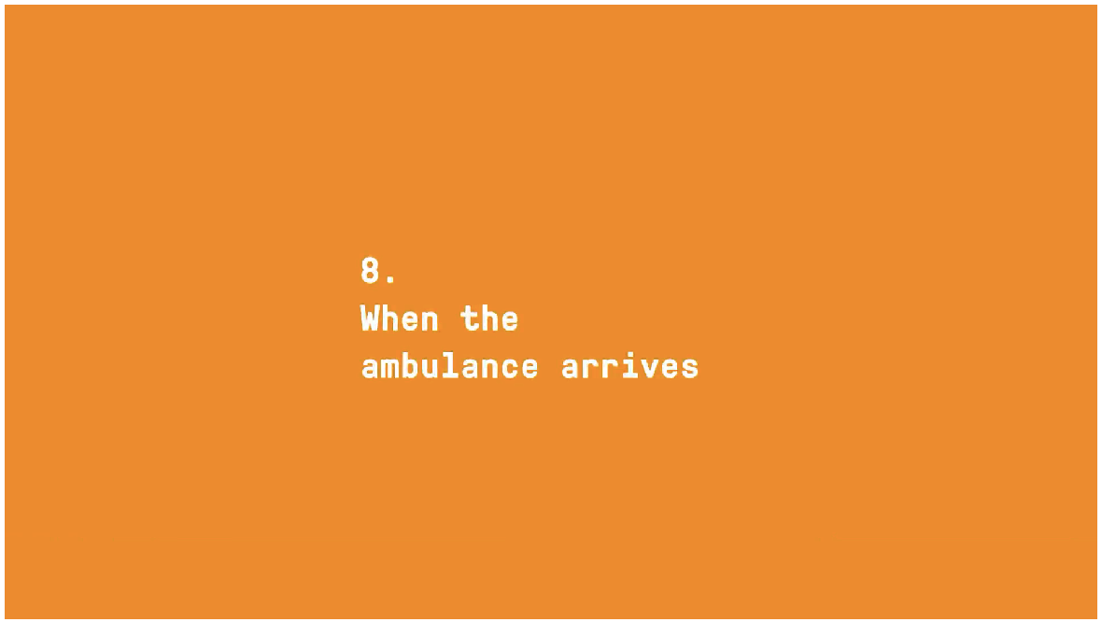

Slide 25
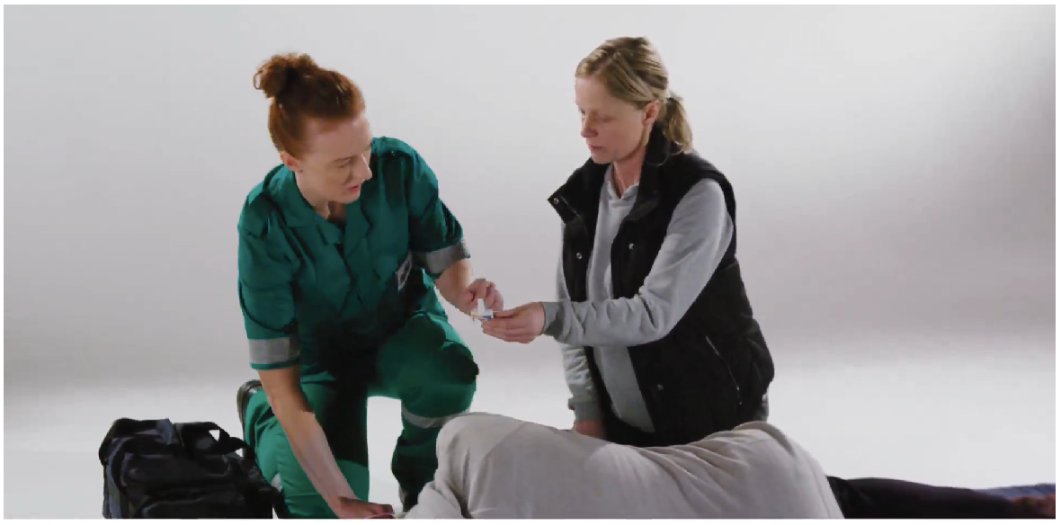
When the ambulance arrives
Tell the paramedic what has happened and that Nyxoid has been administered
Give the paramedic the used Nyxoid spray(s)

Slide 26
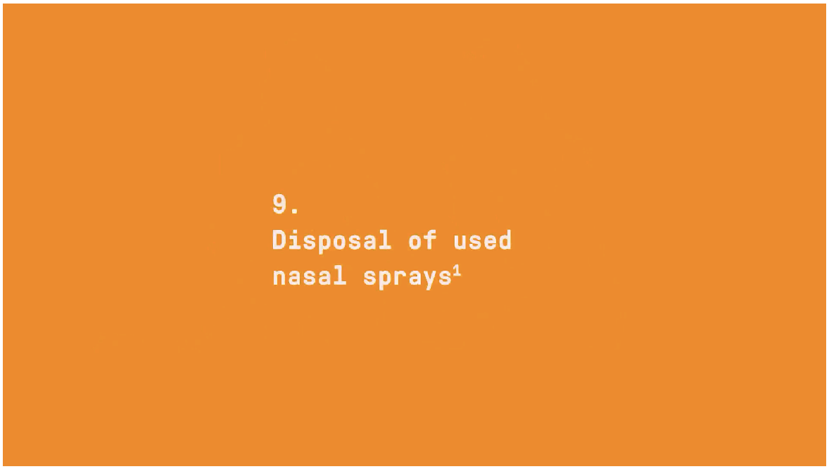

Slide 27
Disposal of used nasal sprays
If you forget to give the spray(s) to the paramedic pass them to a healthcare professional or pharmacist
Arrange for replacement sprays
  Give the person replenishing the spray(s) as much information as possible regarding the circumstances in which the spray was used
Never dispose of used sprays in water or household waste

Slide 28
Supporting information
Supporting information can be downloaded from:
www.nyxoid.com

Slide 29
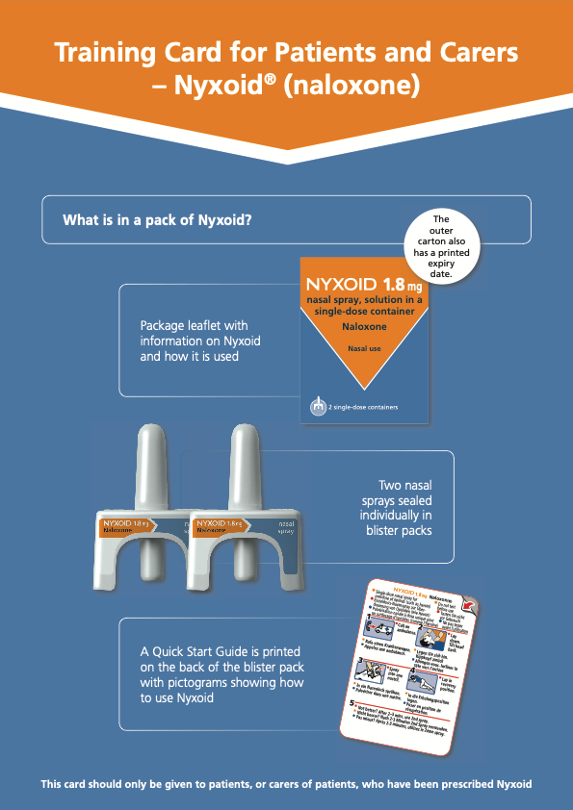
Supporting information
Supporting information can be downloaded from www.nyxoid.com

Slide 30
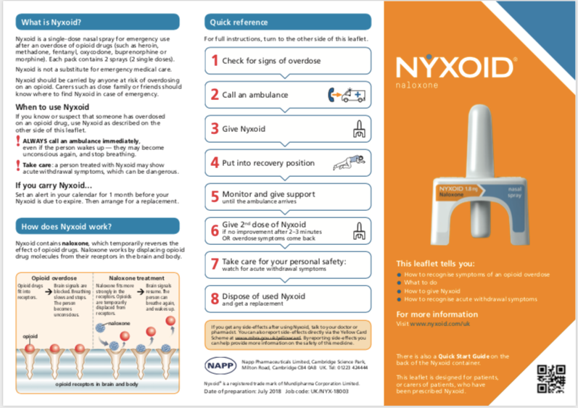
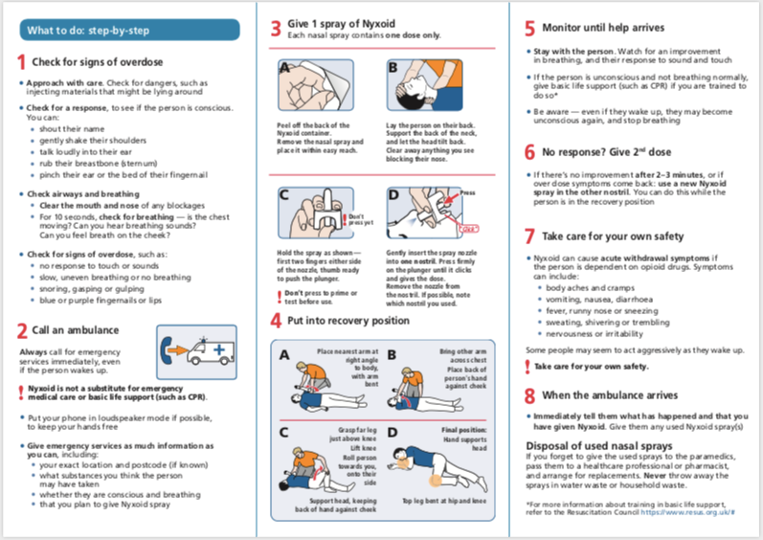
Supporting information
Supporting information can be downloaded from www.nyxoid.com

Slide 31
Contacts
Business Development and Marketing
Mark Tudor – 07837 092449 mark@orionmedical.co.uk
Operations & Quality
Salvatore Picillo - 07917 192238
salv@orionmedical.co.uk
Sales & Technical
Shaun Hazlett - 07876 743750
shaun@orionmedical.co.uk
Accounts & Administration
Deborah Belton - 01869 244423
deborah@orionmedical.co.uk
Customer Service (Order Processing)
Jade Lacey – 01869 244423
jade@orionmedical.co.uk
Customer Service (Waste Collection)
Helen du Plooy – 01869 325912
helen@orionmedical.co.uk

